Slide 1

Technological Institute of the Philippines Manila Campus
College of Information and Technology Education Bachelor of Science in Computer Science Bachelor of Science and Information Technology
PROJECT
Window 8 /8.1 Creating New User CIT 203 – IT32S1
Platform Technology
Submitted by:
Alysson Kyle Castillo Neill Irvin Morales Renz Jordan Paragas
Submitted to: Jenely n Aranas

Slide 2
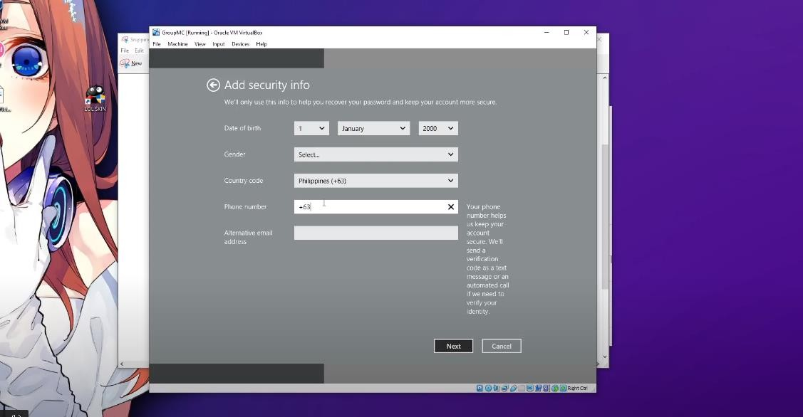
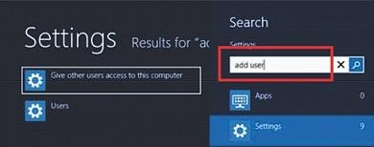
Background
The Purpose of this project is to introduce on how to create a new user of windows 8/8.1 In a simple way. A user account allows you to sign in to your computer. By default, your
computer already has one user account, which you were required to create when you set up your computer. If you plan to share your computer with others, you can create a separate user account for each person.
Discussion of the Project
What is Windows 8?
Windows 8 is a completely redesigned operating system developed from the ground up with touchscreen use in mind as well as near instant-on capabilities that enable a Windows 8 PC to load and start up in a matter of seconds rather than in minutes. Apps - "App" is another word for program.
Windows 8 allows multiple users to share the same computer using different accounts. This allows each user to have their own location where they can store personal information such as documents, pictures, videos, and other files so that they are not mixed in with the files of other users on the same computer.
Before we create a new user, we use Virtual Box to perform this project.
1st, we proceed to add new user to the Windows 8 Start Screen and type "Add User".
When the search results appear click on the Settings category as shown from the image below.

Slide 3
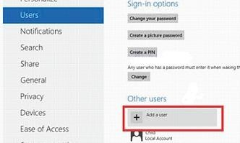
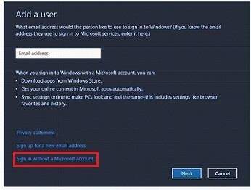
Now we click on the option labeled "Give other users access to this computer", which will open the User Settings screen.
Scroll down and click on the "Add User" option as shown below.
And now at a screen prompting you to enter the user's email address.

Slide 4
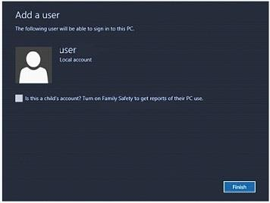
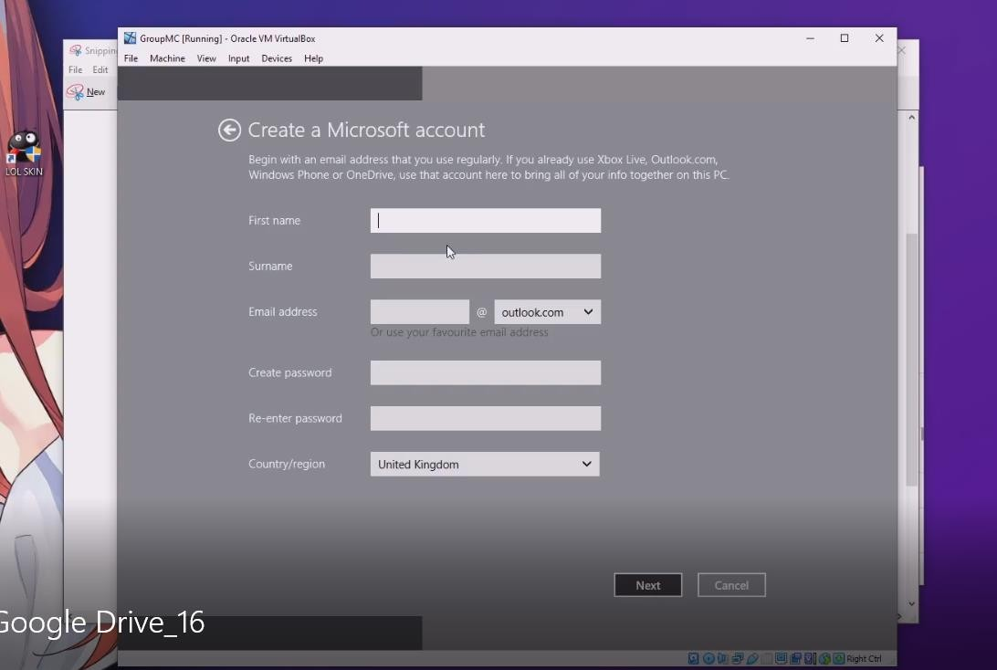
The above screen will prompt you to enter an email to create a Microsoft account. However, you still have the choice to pass that screen without creating a Microsoft account. To do so, you need to select "Sign in without a Microsoft account".
You will be redirected to a screen where Windows will ask if you are sure to make a Local account. Click on the "Local account" button and this will bring you to a new screen wherein you are to input the information you wish to use for the account. You will also need to fill in the desired user name, password, and a hint that will be used to help you remember your password. When you are done filling in the information, please click on the "Next" button
After performing the above steps, you will see a confirmation screen similar to the screen below, showing that your account has now been created.
You can select the Family Safety check box if the owner of the account is a child, if not, you can leave that check box unchecked, then click on the"Finish" button to exit the setup.

Slide 5
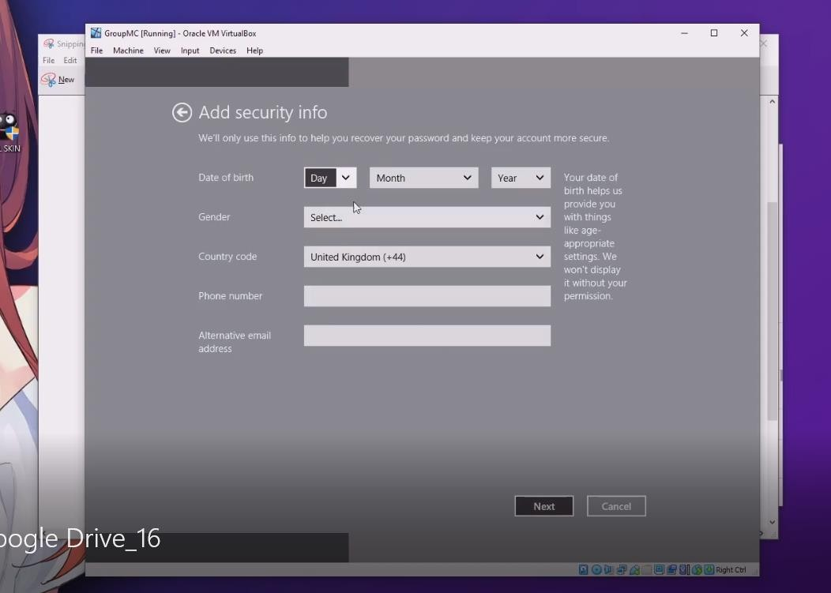
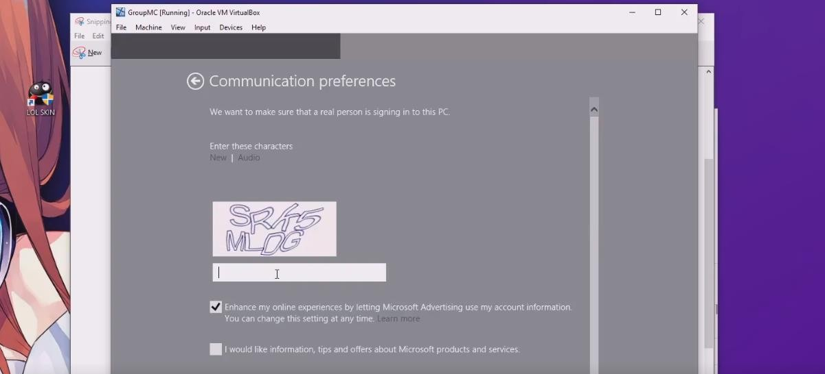
As you can see we proceed in creating a Microsoft Account, which contains first name, surname, email address (created account in Microsoft) password and the country region.
After filling up the Microsoft account, next is proceed into “ADD SECURITY INFO” for the security of your account. The image show below.
After adding information. It will proceed into the Communication Preferences that make sure if the user/ real person signing in the PC.

Slide 6
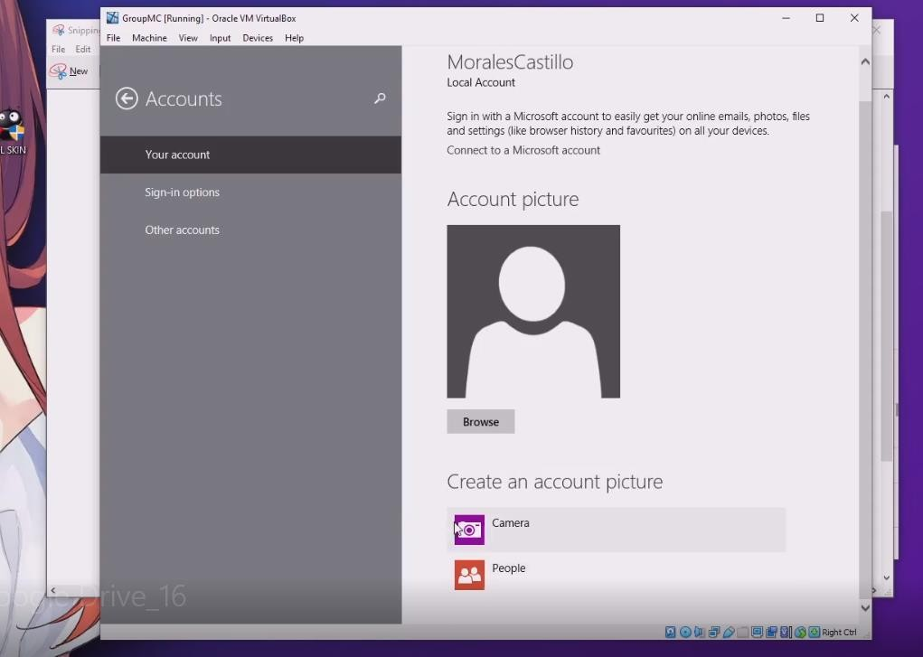
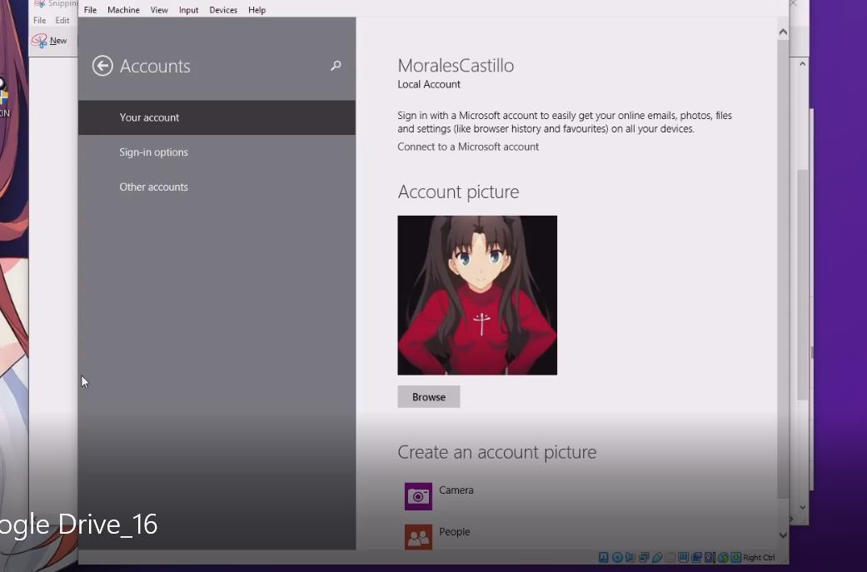
After creating a new user now we proceed to creating a user profile picture.\
And now we add some picture of the created user. To add image click browse and then choose your image profile

Slide 7
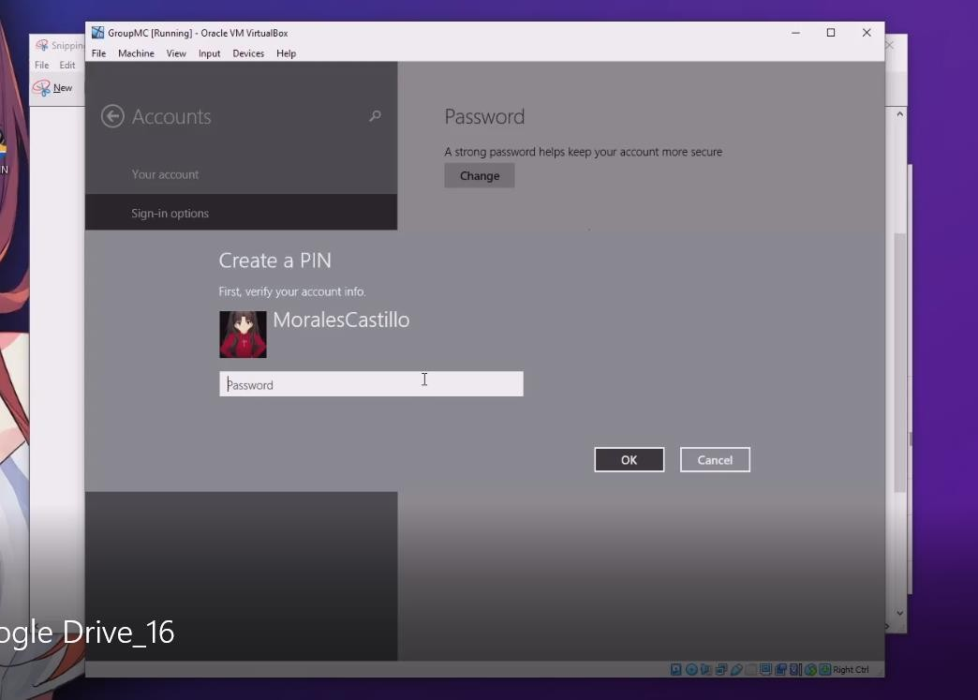
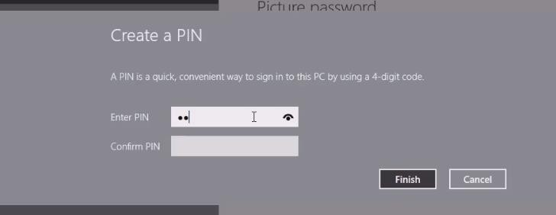
Now we proceed into the Create Pin to verify your account info when you are Sign in to your account
After creating a PIN for signing option. Now you can login your created account.

Slide 8
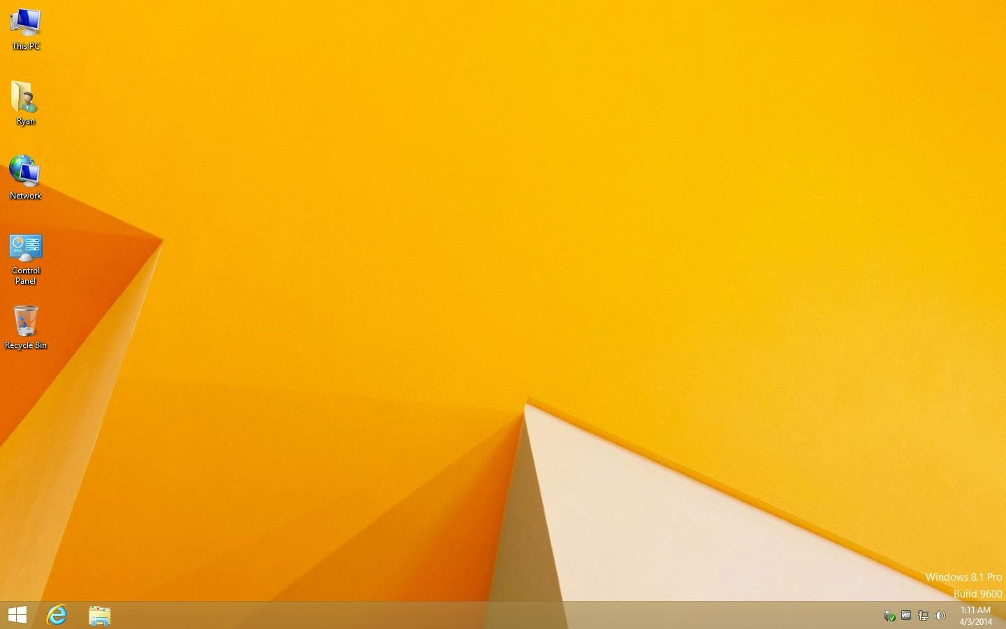
The new user is successfully created.
Conclusion:
These features only touch the surface of what is available to developers for building applications that target the new Windows 8 Metro platform. Microsoft has created a platform that allows you to develop using the language and design tool of your choice, implements complex interfaces in a simple way, and creates unprecedented interoperability between different applications. This coupled with new language features and a consistent experience that is easy to develop for the end user makes it a platform I believe most programmers will love. It is easy to create a new user in this OS. Only need to do is create your account on Microsoft or create as a local user.

